Slide 1

Workshop Guide
Integrated Therapies Institute promotes cutting edge advances in manual and movement education by hosting a wide array of internationally recognized instructors at our beautifully outfitted, purpose-built and environmentally friendly teaching center.
ISTSportsTherapies.com

Slide 2
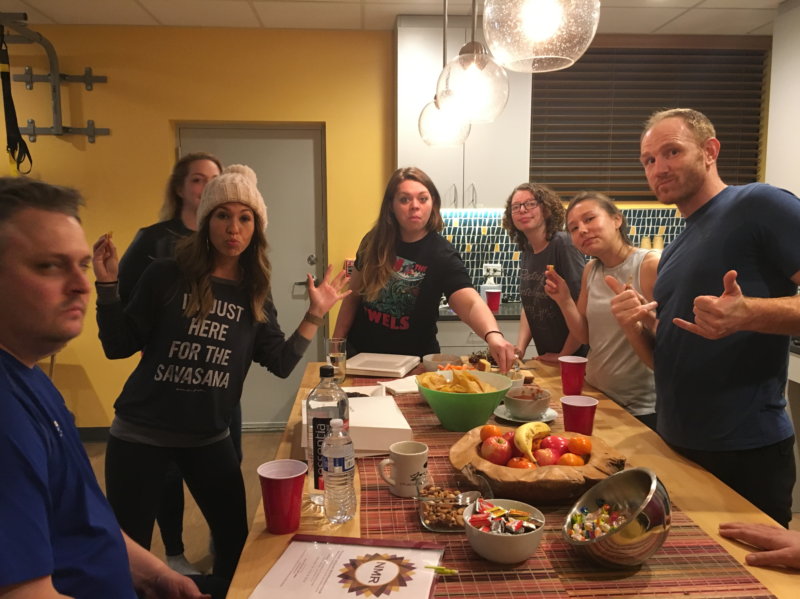

Workshop Guide
Welcome to Integrated Therapies Institute
We’re excited to host you for this amazing educational experience. Please take a moment to read through the following information which addresses important subjects from travel and lodging, to parking and Wi-Fi codes.
ISTSportsTherapies.com

Slide 3
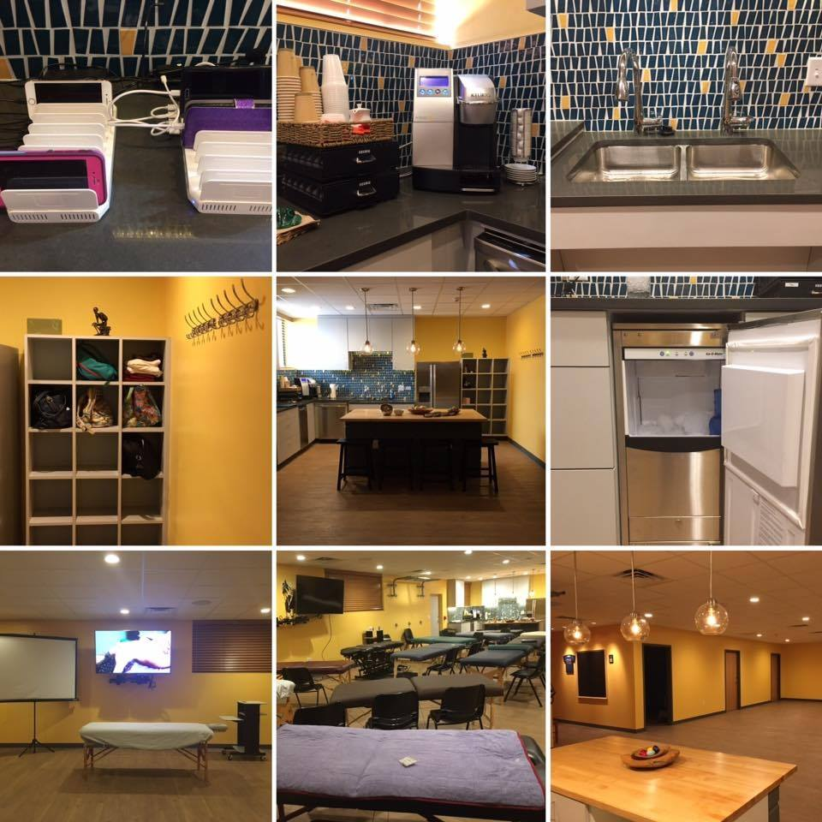
Workshop Guide
Amenities
Full-sized refrigerator with filtered water
Commercial Keurig station stocked with your favorite coffees and teas
Basic hearty and healthy snacks
Device charging station
Sonic ice maker
Toaster
Microwave
Cubby storage for your personal items
Dual handwashing station
ISTSportsTherapies.com

Slide 4
Workshop Guide
Things To Bring And Know
Those who are not flying should bring a therapy table. If this is not possible, please notify the instructor or host in advance
Students are required to supply their own sheets, towels, lubricants, etc.
Out of sensitivity for those with allergies or migraines, we ask that you refrain from using any scents including perfume, cologne and essential oils
As we have a full-size refrigerator and microwave, feel free to bring your own food and beverages
There is ample, free parking in our back lot with direct entry to the Institute
The building door code is 1492 (needed on weekends)
Restroom code is 1492* - ladies room handle only lifts up
Wi-Fi login: IST
Password: 123456789
ISTSportsTherapies.com

Slide 5
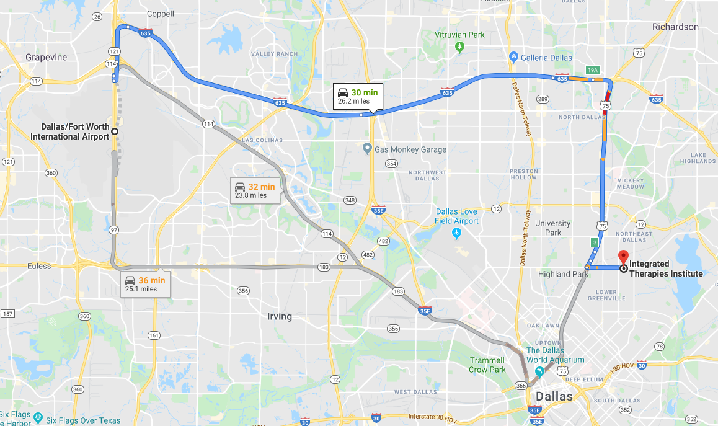
Workshop Guide
Getting Here From Airports
From DFW International | 23.8 miles 32 mi
ISTSportsTherapies.com

Slide 6
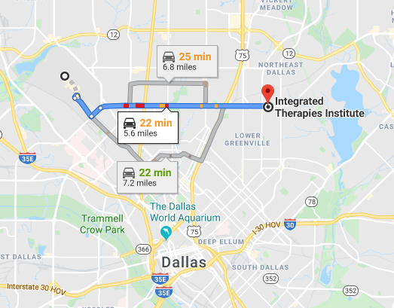
Workshop Guide
Getting Here From Airports
From Dallas Love Field |5.6 miles 23 min
ISTSportsTherapies.com

Slide 7
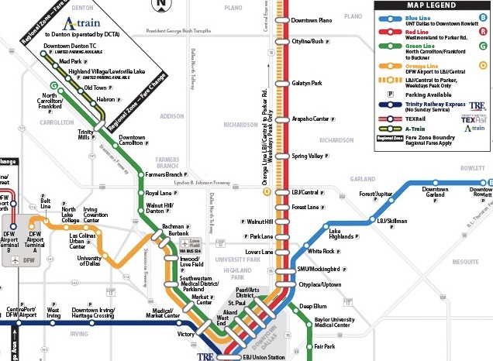
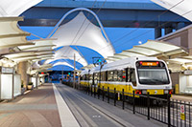
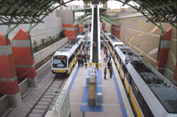
Workshop Guide
Getting Here From Airports
Riding DART Light Rail to ISTI
Want to save money and travel stress free from DFW Airport? You can take the DART light rail from DFW airport to within 1 mile of the Institute with no transfers.
$2.50 for a 2 hour pass and bags ride free
Depart from:
DFW International Airport, Terminal A
(American Airlines Terminal)
2049 N. Service Road, DFW Airport 75261
TAKE the ORANGE LINE
Arrive at:
SMU/Mockingbird Station
Mockingbird Lane and North Central Expwy.
5465 E. Mockingbird Lane, Dallas 75206
From Mockingbird Stations, you can walk, take Uber/Lyft/taxi or bus to your place of lodging or ISTI (1.2 miles)
For public transit assistance, call DART Customer Service at 214-979-1111 or visit DART.org
https://www.dart.org/riding/DARTHowToRideToDFWAirport.pdf
ISTSportsTherapies.com

Slide 8
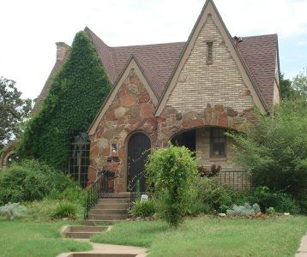
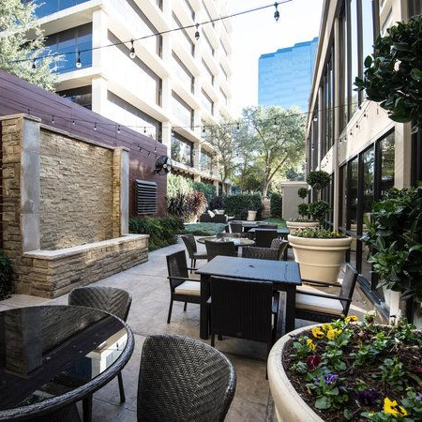

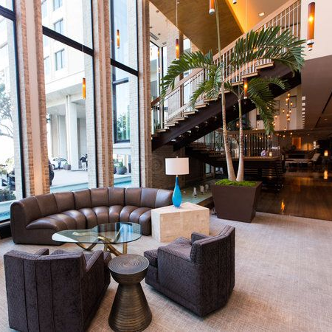
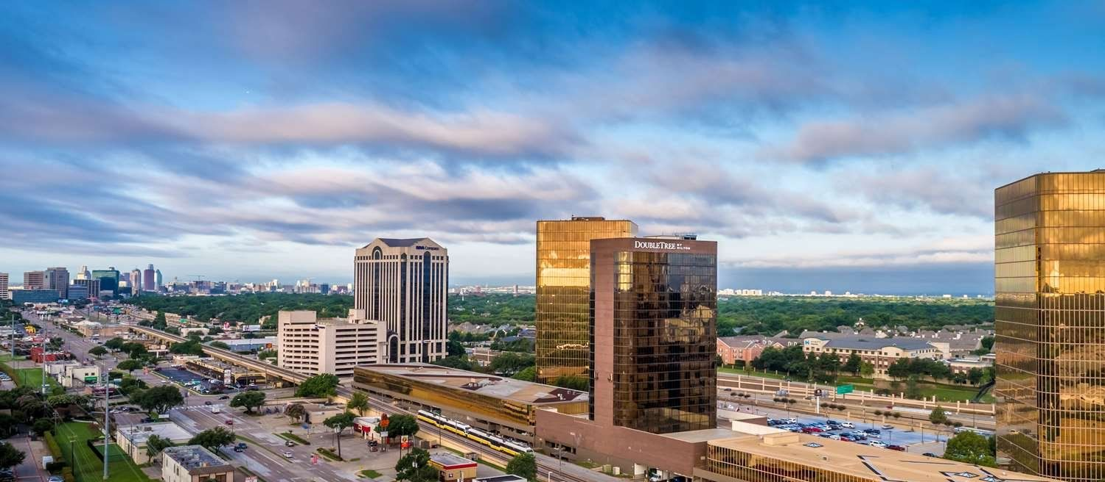
Workshop Guide
Lodging and
Accommodations
The Highland Dallas – Curio Collection by Hilton
The Magnolia Hotel - Park Cities
Doubletree Hotel - Campbell Centre
La Quinta – Uptown
Airbnb near ISTI
VRBO near ISTI
ISTSportsTherapies.com

Slide 9
Workshop Guide
Restaurant Guide
1. Snap Kitchen – Healthy, pre-prepared and portion-controlled meals, snacks and drinks.
2. Big Shucks - Fresh grilled and fried seafood in a casual oyster bar style environment.
3. Burger House – A local favorite. Delicious burgers and chicken sandwiches. They’re famous for their French fry seasoning and the tots and onion rings are also tasty.
4. Subway Sandwiches – Quick and easy sandwiches.
5. Poke Bop - Fast, fresh and delicious traditional Hawaiian poke bowls along with sushi rolls and bubble tea.
6. Ginger Thai – One of Dallas’ best Thai restaurants. If you are dining during lunch, ask for your check when ordering as they can be a bit slow.
7. Lover’s Pizza and Pasta – Family owned/operated with all food made from scratch. Not in the mood for Italian? Try one of their delicious salads, Philly cheesesteak and grilled chicken sandwiches.
8. Taco Joint – Locally owned, casual Tex-Mex restaurant specializing in tacos and taco sauces.
9. Boston Market – Chicken with all the fixings.
10. Manny’s Uptown Tex-Mex – Festive environment with extensive and delicious Tex-Mex offerings.
11. Olivellas – Voted best pizza in Dallas, they specialize in thin Neapolitan style pizza. Their salads and pasta dishes are spectacular as well.
12. Dream Café - Offering organic, vegan and healthy options along with smoothies in a fun, bright environment. Their service and kitchen are very slow, so plan ahead and call your order in for pick-up.
ISTSportsTherapies.com

Slide 10
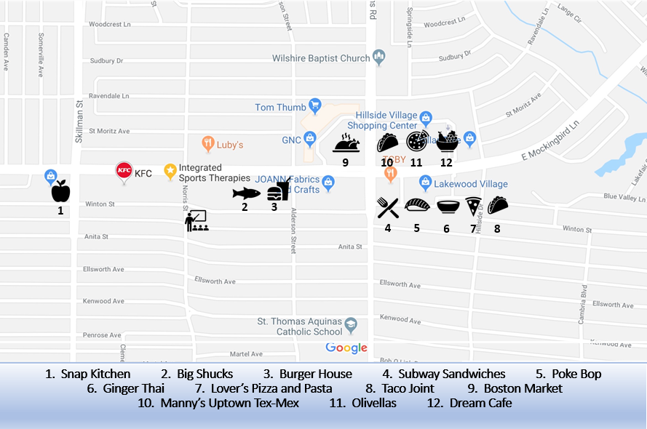
Workshop Guide
Restaurant Map

Slide 11


Workshop Guide
Stay Connected…
Follow us on Facebook and Instagram
@IntegratedTherapiesInstitute
Join our newsletter HERE
ISTSportsTherapies.com

